Slide 1
Retail E-Business
The Transformation Has Begun

Slide 2
Contents
Why e-Business ?
  Definitions
  e-Business Framework
  How e-Business will Transform the Retail Sector
  Industry requirements
  Examples
Retail Business Process Models
  Today
  Future as a result of the impact of e-Business
Retail Business Systems Architecture
CIP Solution Set

Slide 3

E-Business: Definitions
“e-Business is using electronic information to improve performance, create value and enable new relationships between businesses, their suppliers and customers”
Buy-Side
Sell-Side
Plan Categories
& Assortments
Replenish &
Allocate Products
Supplier network
Develop Products
Distribute
Products
Customer network
Source & Buy
Products
Sell to & Serve
Customers
“e-Commerce is the electronic buying, marketing, and selling of products and services”

Slide 4
Our Vision: E-Business Evolution
Retailers are focusing their current efforts here …
… with the ultimate goal
of being successful here
Restructuring the value chain to create “many-to-many” relationships, new value propositions & new business models
4 - Industry
Transformation
Companies entering new industry sectors and competing outside of their core business areas
3 - Convergence
2 - Value Chain
Integration
Connections with trading partners & process changes across the value chain (buy side or B2B)
Degree of change to business model
1 - Channel Enhancement
Enhancing current channels and adding new channels to market (sell side or B2C)
0 - Enterprise Connectivity
Internet technology enabled process, systems & organizational change & getting the organization connected
Role of E-Business

Slide 5
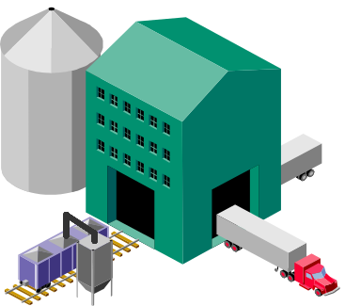
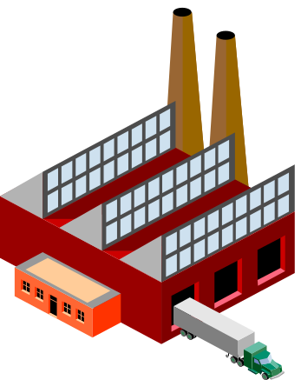

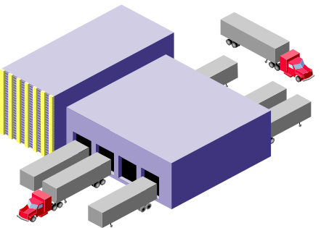
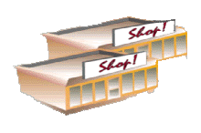

Traditional Value Chain … the beginning
Supplier
Manufacturer
Distributor
Store

Slide 6



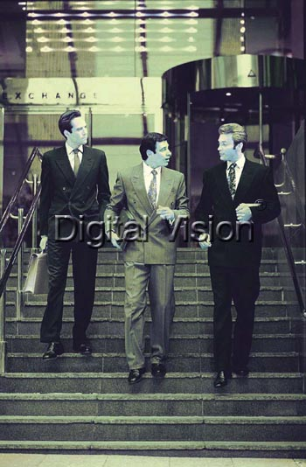

Stage Zero - Enterprise Connectivity
Supplier
Manufacturer
Banks
Distributor
Potential Recruits
Store
Business Advisers
“Getting connected within the organisation”
Service Providers
Employees

Slide 7
Why E-Business? … The Case for Enterprise Connectivity
Cost savings
  reduction of physical infrastructure & labor costs (90% cost savings in using Internet over traditional WANs & VANs)
  lower cost connectivity for a global business
Leveraging assets & expertise internally
  make data & information widely available in the organization
  share knowledge & expertise
Improve effectiveness of business operations
  simplification of tasks
  Implement information and business processes more quickly & effectively
  create greater visibility & control
Instantly connect geographically dispersed businesses
  facilitate communication & collaboration
Ubiquitous technology platform
  lower cost technology platform
  upgrades easier, fewer
  single platform for both intra- and inter-enterprise connectivity

Slide 8

Channel Enhancement - Opportunities
Outsourced Services
Business Advisors
Financial
Services
Investors
Knowledge
Management
Work Flow
Document
Management
Suppliers
Consumers
Process
Management
Web Enabled
Collaborative
Working
Enterprise
Systems
Retailer
Internet
Based WANs
Recruitment
Employee
HR Services
Intranets
Potential Recruits
Stores
Factories
Employees
Internet technology enabled process, systems & organizational change
Notes:
Intranet Deployment
Internet Based Wide Area Networks
Knowledge Management Processes & Technology
HR Services (e.g. recruiting, benefits)
Process Management Technology (for Promotions, New Product Introduction
Collaborative Working Technology
Internally, among different divisions / locations
Web-Enabled enterprise systems
Virtual Head Offices

Slide 9
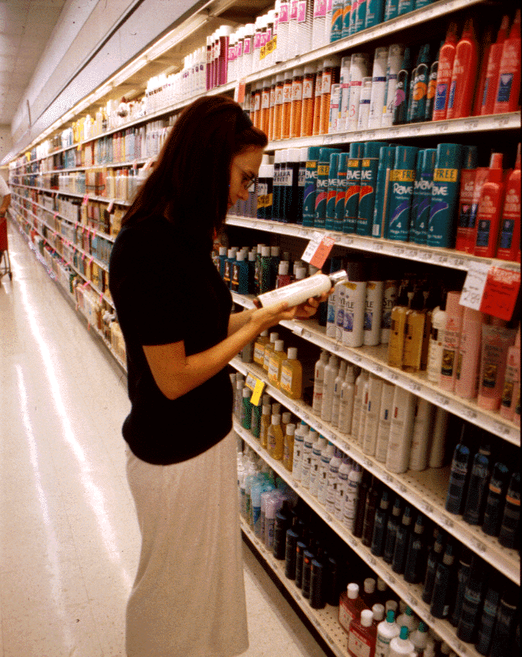
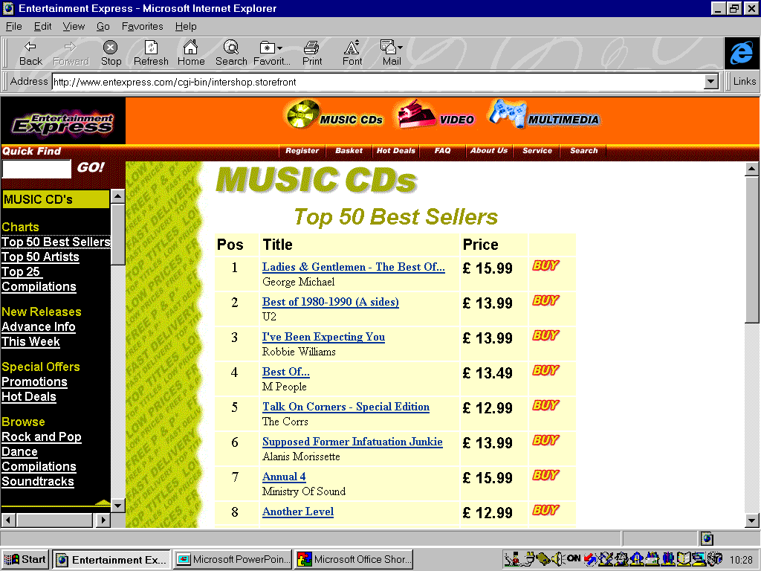
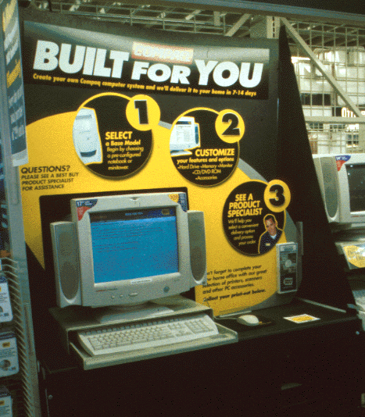

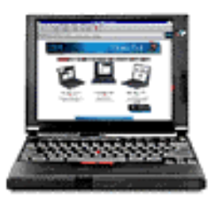
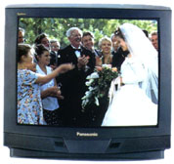
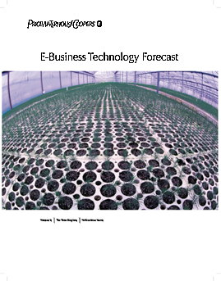
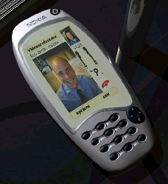
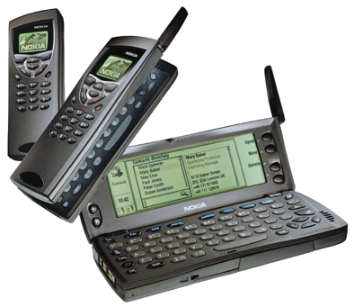

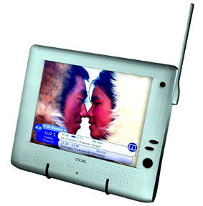

Channel Enhancement
Supplier
Manufacturer
Distributor
“Enhancing and Expanding Channels to Market”
RETAILER
CONSUMER

Slide 10
Why E-Business ? …. The Case for Channel Enhancement
Expanding revenue streams by opening new products / services and markets / customers (both consumers & other businesses)
  Product Testing / Development
  Mass Customization
  Close-out / Inventory Management
Enhancing and personalizing their offer
  Customer Service
  Merchandise
  Marketing
Enhancing and customizing the shopping experience
  Expanded merchandise information
  New merchandising techniques
  Personalization
Extending marketing, advertising, and brand reach
  Cross-channel marketing
  Customer relationship management

Slide 11
Channel Enhancement - Opportunities
Stores
Catalogues
Consumers
Retailer
Suppliers
Auctions
Knowledge
Management
Work Flow
Document
Management
Kiosks
Process
Management
Web Enabled
Enterprise
Systems
Websites
Collaborative
Working
Other Businesses
Internet
Based WANs
PDAs, Mobile
Phones, etc.
Intranets
Recruitment
Employee
HR Services
Interactive TV
Corporate
Intranets
Multiple channels, fully integrated with business process, enterprise systems and organization
Notes:
Intranet Deployment
Internet Based Wide Area Networks
Knowledge Management Processes & Technology
HR Services (e.g. recruiting, benefits)
Process Management Technology (for Promotions, New Product Introduction
Collaborative Working Technology
Internally, among different divisions / locations
Web-Enabled enterprise systems
Virtual Head Offices

Slide 12
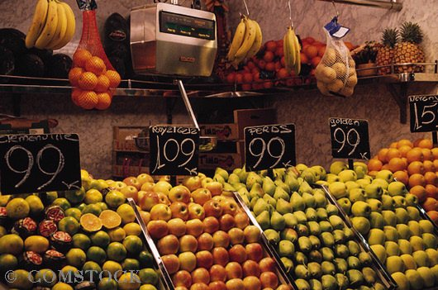
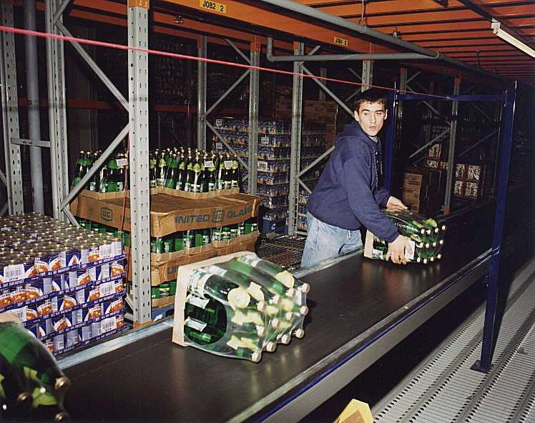


Our Vision of the Evolution of Multi-Channel Retailing
Integrated Multi-Channel Retailing
Gap
Amazon ?
JC Penney
Home Depot?
Hybrid Multi-Channel
Hybrid Multi-Channel
+ stores
Tesco
Bn.com
Wal-Mart
Petsmart.com
Comet, Darty, Woolworths, Argos
Amazon.com
Traditional Bricks & Mortar
+ new channels
PurePlay (eTailer)
+ distribution infrastructure
Harrods
Boo.com
eToys
Notes:
The future - a Clicks & Mortar universe dominated by two groups : tightly focused terrestrial retailers with strong brand names that sell well on the web and Web / Land stores that offer everything, either from one store or a confederation”
Arm’s length relationships to avoid suffocation by stodgier bricks & mortar businesses
Stock market spin-offs can create necessary currency for reward & acquisition

Slide 13
Three Business Models
Store Retailer +
On-Line Extension
Multi - Channel
Retailer
Pure Play
(eTailer)
  Store-based business, with an on-line channel added on
  Merchandise selection largely mimics the in-store assortment. Traditional relationships with suppliers
  Limitations of store-based business apply (e.g. buying cycles)
  Electronic storefront system added to enterprise systems (and sometimes integrated)
  Integrated business across store and direct channels
  Matrix organisation, with responsibility areas around Customers, Brands, and Channels
  Significantly extended range of products and services, different trading relationships with suppliers
  Best of breed systems for each channel, supported by an ERP backbone. CRM systems are a key differentiator
  Separate direct business with own organisation, processes & systems
  Unlimited range, multiple trading relationships with suppliers
  New systems for electronic commerce and back-office
  Fulfilment & back-office systems either in-house or outsourced

Slide 14
Channel Enhancement - Competency Requirements
HR / Organization
Finance / Tax / Legal
Business Strategy and Propositions
Marketing and Customer Management
Corporate Competencies
Personalization
and Data Mining
Retail Planning, Buying and Inventory Management
On-line
Merchant
Content Management
Industry
Competencies
E-Business
Competencies
Catalog Fulfillment, Call Centre, and Customer Care
Technical Architecture
Systems
Development &
Integration
Service and
Communication
Site Administration &
Support
Transforming from a retailer to an e-tailer requires a mixture of many different competencies

Slide 15
Value Chain Transformation
Supplier
Manufacturer
Distributor
Store
“Buy-side (upstream) connections with trading partners & process changes across the value chain”

Slide 16
Why E-Business ? …. The Case for Value Chain Integration
  Cost Reduction (e.g. Procurement)
  Increase Speed of Doing Business
  Optimize Entire Value Chain
  Respond to Increasingly Complex Consumer Demand
  Increase Margin and Profit

Slide 17
Three dimensions of collaboration between trading partners
Relationship
How we transact?
What products?
Product Development
Supply Chain Excellence
How we replenish?

Slide 18
… Collaborate, but how far?
Common strategic objective
Vendor Managed Inventory
Joint product launch
“Implants”
Joint Replenishment
Joint project working
Account Management
Forecasted Orders (DRP)
Regular discussions on product direction
Order taking
Regular Orders
Brief issued, responses invited
Trading
Random Orders
Sell the catalogue
Relationship Maturity
Replenishment Method
Joint Product Development relationship

Slide 19
Value Chain Integration - Different Areas of Collaboration
Manufacturer
Soft, Unstructured ...
Retailer
Strategic Alliance
Future Strategy, Product Portfolio Development, Consumer Insights
Develop Strategy &
Propositions
Develop Strategy
Plan Products & Offers
Joint Business Management
Strategic Capacity Management: Collaborative relationship management: New Product Development
Plan Categories
& Assortments
Develop Products
& Services
Develop Products
Perform Marketing
&Sales
Joint Category Management
Category Structure, Policies, etc.: Assortment Planning: Space Planning: New Product Introduction: Promotions Management: Product Catalogues, Specifications, Prices
Source & Buy
Products
Plan Supply Chain
Replenish &
Allocate Products
Manufacture
Products
Procure Materials
Joint Supply Management
Collaborative Planning, Forecasting & Replenishment: Shared production, inventory & sales data: Vendor managed inventory
Distribute
Products
Distribute Product
Joint Transaction Management
Orders: Advanced Shipping Notifications: Deliveries: Goods Receipt Notes: Invoices: Payments
Sell to & Serve
Customers
Manage
Customer Relationships
Perform Customer
Service
… Hard, Structured

Slide 20
Connectivity - A Whole New Set of Options
Suppliers
Collaborative
Planning
Collaborative
Working
Collaborative
Planning
Supply Chain Planning
Retailer
Extranet
Extranet
Work Flow
Document
Management
Collaborative
Planning
Information
Sharing
Stores
Web Enabled
EDI
Gateway
Enterprise
Systems
Catalogues
Consumers
Web
Reporting
EDI Gateway
Auctions
Online
Selling
Online
Catalogues
Knowledge
Management
Kiosks
Process
Management
Websites
Other Businesses
PDAs, Mobile
Phones, etc.
Data
Interchange
Consumables
Catalogues
Collaborative
Working
Intranets
Procurement
Interactive TV
Third Party
Internet
Based WANs
Market
Places
Trading
Exchanges
Market Sites
Corporate
Intranets
Recruitment
Employee
HR Services
Infomediaries
Auctions
Buy Side
Catalogues
Aggregators
Reverse
Auctions
Industry Integrators

Slide 21
e-Collaborative Planning Model - a variety of objectives
e-procurement
(trading)
e-trading communities
(customer led)
e-integrated planning
(joint demand & capacity planning)
Constant Demand
The objectives, tools & methods of collaborative planning vary in line with demand & supply characteristics
Disrupted
(e.g. promos, seasonal)
e-trading communities
(supplier led)
Demand Characteristics
e-interconnectivity
(make & break connections freely
Erratics
e-procurement
(search then lock with ATP / ATC)
One-offs
Commodity
Many potential
Few sources
One constrained source
Supply Characteristics
Notes:
The application of Collaborative Planning, Forecasting & Replenishment (CPFR) and e-collaboration models depends on being clear on what is to be achieved between both parties.
A central proposition is that the task changes depending on the demand and supply situation that is being planned. This model talks this through
Demand & supply characteristics influence two critical dimensions
the mix of trading versus collaboration in the relationship
the mix of one-off activity (when the focus of planning will be to make the event happen effectively) versus sustained relationships where the issues will be about achieving lowest continuing relationship cost for both partners
Broadly:
the more constrained the supply and the more constant the demand the more collaborative and relationship focused the relationship needs to be
the more widely available the product the more the tendency to trade
the more unstable the demand the more the need to focus on managing events

Slide 22
Evolutionary Steps
Processes
Supply Chain Optimisation
People
Integrate with Customers & Suppliers
Systems
Virtual Supply Chain
Synchronisation of Supply with Demand
e-supply chain
Inter-business Working
Reliability & Flexibility
External Communications
Cross-functional working
Internal Communications
Functional Working
Simplification & Control
Transaction Processing
Individual skills & disciplines
Data Accuracy
Improvement focused outside the organisation
Improvement focused inside the organisation
Notes:
This is a simple ,model in tracking where you are in organisational management of demand peaks.
You cannot sort out the suppliers until your own house is in order and you cannot move up in just one dimension- systems, people and processes have to move in parallel
Increasingly to manage demand peaks it is critical to be operating with other businesses this creates another ‘staircase’ of relationship development...

Slide 23
Convergence
Supplier
Market Site
Trading
Exchange
Manufacturer
Auctions
New
Intermediary
eTailers
Distributor
New
Intermediary
Store
Consumer
Direct
New Services
Infomediaries
“New entrants selling to consumers, new services linking businesses, increase in vertical integration”
Other
Industries

Slide 24
Convergence is already happening in the physical world
Electricity companies
look at Internet access via wall sockets
Electricity
Citigroup,
many others
Travel
Information
Technology
Psion + Nokia, Ericsson
Insurance
Enter- tainment
Telecomms
Banking
Retail
Broad- casting
Consumer Goods
British Telecom
+BSkyB=BIB
Sainsbury,
Barclay Square
Loblaw
Cablevision
Disney Stores, Warner Bros
Nike, Levi, Nine West, Bose
Notes:
Value enhancing opportunities based on figures calculated by AC.
Revenue side obviously based on small number of examples and depends on your product. Best ones are
B2C - computer related, digital, non-experience goods (i.e. do not have to touch or hear) e.g. books - Leading examples would be Cisco & Dell
B2B - MRO
First mover advantage are around setting standards and establishing e-brands e.g. power of portals: 18 months ago most observers thought AOL would go under - now buying Netscape: NetCenter plus AOL will have 44m visitors combined vs 29M for Microsoft Network - plus 70m on Netscape’s browser
Is a real threat of commiditisation e.g. talk about threat to suppliers using CommerceOne type solutions.
New entrants are always worth thinking about - talk about disintermediation and reintermediation
Be careful not to screw up your legacy business model before new one has taken shape
Industry attractiveness is important i.e. in the Porter sense of does a firm want to be a player in an unattractive industry - Value chain integration can make industries less attractive because
Economies of scale less important - part. If product is digital
Lower switching costs (generally)
Lower capital requirements (generally but IT expensive)
Easier for competitors to enter

Slide 25



















The internet is speeding convergence in retail as new and existing companies enter the “direct selling” model
Infomediaries
Retailers
Aggregators / Communities
Manufacturers
Facilitators
Direct Sellers
Multi-Strategy
Electronic Markets

Slide 26
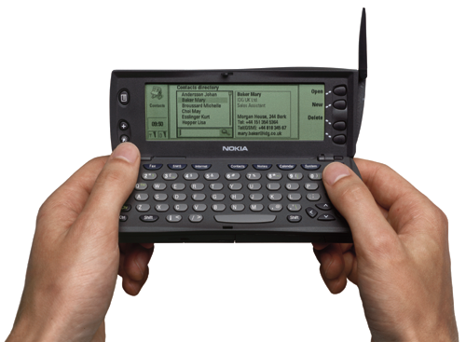
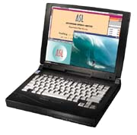

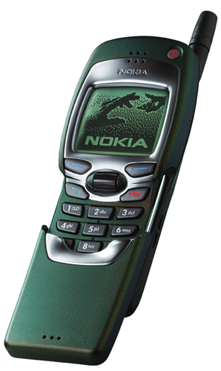

Stage Four -Industry Transformation
Through E-Business, the definition of a “retailer” will become the company who manages commerce relationships with consumers
E-tailer
?
Other
Industry
Manufacturer
Retailer
Distributor
Infomediary
“Many-to-many relationships, new entrants, new types of businesses, new business models”
Auction
Trading
Exchange /
Market

Slide 27



Industry Transformations often take time.
E-Business will be no different.
Technology standards often require time for clear winners to emerge
Consumer shopping behavior changes may take even longer
Notes:
American Airlines have implemented a set of customer-care databases that centralise all of the company's content. The personalization project, aimed at ultimately generating new revenue streams from the 31 million members of American's frequent flyer program, will be used to create custom Web experiences. As for American, it will roll out what appears to be one of the most complex of the current efforts. Using an architecture that rides on top of its Web services, personalization will be extended to 56 interactive applications, invoking more than 200 separate business rules.
American plans to use the site as a way to extend affinity marketing programs to its advertising partners. Citibank, Hertz and Hilton Hotels Corp. are among pilot advertisers in the Web program. Beyond new marketing revenue, American plans to extend the database for use at call centers before the end of the year.

Slide 28
Contents
Why e-Business ?
  Definitions
  e-Business Framework
  How e-Business will Transform the Retail Sector
  Industry requirements
  Examples
Retail Business Process Models
  Today
  Future as a result of the impact of e-Business
Retail Business Systems Architecture
CIP Solution Set

Slide 29
Retail Business Process Model
Manage the Business
Develop Strategy & Propositions
Manage
Brand
Manage Business Performance
Manage Customer Relationships
Plan
Categories /
Assortments
Develop
Products
Operate the Business
Source
& Buy
Products
Replenish
& Allocate
Products
Distribute
Products
Sell to
& Serve
Customers
Manage Promotions / Events
Manage Content
Support the Business
Manage People
Manage Information
& Systems
Manage Operations
Manage Property
Manage Legal & Regulatory Affairs
Provide Financial Services

Slide 30
Changes to Business Process - Conclusions
  For most retailers, the current operating environment focuses on a single channel environment, while the future model will emphasize operating multiple channels.
  However, for most retailers, the overall process model will not change.
  There will be differing degrees of change within many of the business processes themselves, as shown on the following page
  Different operating models will exist for e-tailers, infomediaries, auctions, brokers, buying agents, and other transaction facilitators

Slide 31
Retail Business Process Model
Manage the Business
Develop Strategy & Propositions
Manage
Brand
Manage Business Performance
Manage Customer Relationships
Operate the Business
Plan
Categories /
Assortments
Develop
Products
Source
& Buy
Products
Replenish
& Allocate
Products
Distribute
Products
Sell to
& Serve
Customers
Manage Promotions / Events
Manage Content
Support the Business
Manage People
Manage Information
& Systems
Manage Operations
Manage Property
Manage Legal & Regulatory Affairs
Provide Financial Services
Fundamental Change
Some Change
No Change

Slide 32
Develop Strategy & Proposition
Current (Single Channel)
  Stores are the primary channel; Reactive approach to on-line selling in the face of emerging e-tailers and “clicks & mortar” players
  Investments geared toward supporting existing business
  Known competitors; Easy to differentiate offer
  Strategy oriented toward a single market position / customer segment
  Emphasis on selling merchandise, with some experimentation into non-core offers
  Convergence in the physical world
  Key appeals are Price, Selection, and Convenience
  Customer base largely dictated by geography and demographics
  Primary Value in Tangible Assets - Inventory / Real Estate
  Business Strategy developed as part of formal planning process
Future (Multi-Channel)
  All retailers operate via multiple channels - in-store, on-line, and catalogue; Proactive approach
  Wider portfolio of investment options
  (e.g. new channels, convergence)
  Multiple, unknown competitors with different business models; Difficult to differentiate offer
  Multiple strategies, oriented to specific customer segments
  Emphasis on managing relationships, with expansion into new services / sectors becomes commonplace
  Convergence across channels
  Service, fashion, information, and community added to Key Appeals
  Global customer base, largely dictated by lifestyle and shopping preferences
  Primary Value in Intangible Assets - People, Information, Brands
  Strategy developed on an ongoing basis, with shorter timeframes and more frequent revision

Slide 33
Manage Brand
Current
  Retail brand less important than manufacturer brand; Brand association with stores / products
  Primarily regional and national brands
  Broadcast mediums receive the majority of promotional spending
  Senior Executive time largely spent on operational issues and performance monitoring
Future
  Less distinction between retail and manufacturer brand; Brand association with lifestyle and customer offer
  Migration to global brands
  Promotional spending mixed among broadcast, narrowcast, and direct messages
  Senior Executives focused on building / managing brand image to create competitive advantage

Slide 34
Manage Customer Relationships
Current
  Beginning to emerge as a competency
  Basic methods used to capture customer behaviour & preferences
  Few transactions can be linked to specific customers
  Little or no understanding of customer shopping process
  Targeting is informal and unstructured
  Emphasis on customer attraction
  No organizational responsibility for customer management
Future
  Primary source of competitive advantage
  New, more sophisticated loyalty schemes, spanning channels
  All purchase transactions can be linked to individual customers
  Detailed tracking and interpretation of customer shopping
  Targeting based on Lifetime Value
  Emphasis on customer retention
  Chief Customer Officer emerges to manage customer relationships

Slide 35
Manage Business Performance
Current
  Heavy emphasis on managing and measuring the productivity of tangible assets (e.g. inventory, space, people)
  Difficult to get the right information to the right people in a geographically dispersed business
  Performance emphasis on static ROI
  (e.g. Profit, ROA, ROCE)
Future
  Inventory and space productivity taken for granted; Management focus shifts to managing intangible assets (e,g, information, customers, brands, knowledge)
  Everyone will be connected - information instantly available over a free virtual private network
  Performance emphasis on Free Cash Flow (e.g. SVA, EVA), with time sensitivity (e.g. Real Options)

Slide 36
Plan Categories / Assortments
Current
  Number of categories, assortment breadth, depth, and structure, and policies and plans restricted by amount of space and target market and management bandwidth
  Prices set in static and insular manner
  Space planning emphasizes productivity and is governed by amount of square footage
  Emergence of collaborative planning and joint category management
  Discrete, stand-alone process
Future
  Only limitations on category expansion are brand image and ability to execute; Greater flexibility in structure, policies, and plans
  Pricing set in real time, resulting in dynamic / variable price points; pricing becomes transparent to customers
  Space planning also focuses on presentation, layout, and ergonomics
  Collaboration throughout the value chain, enabled by total visibility of information
  Ongoing, integrated process

Slide 37
Develop Products
Current
  Most products mass produced; with minimal consumer input
  Largely physical process with suppliers meeting retailers and discussing paper designs, samples, etc.
  Difficulties in managing product development process - tracking movement of product from source factory through shipment from overseas and into retailers possession
  Long lead times
Future
  Mass customization / configure-to-order will become more common
  More of an electronic process with designs, images, etc. exchanged electronically, manipulated using design software to produce selections
  Online tracking of product flow from concept, through manufacturing, inbound supply chain and all the way through to end customer
  Shorter lead times

Slide 38
Source & Buy Products
Current
  Long process, requiring extensive travel, face-to-face contact, and work required to find the appropriate suppliers, products & services
  Sourcing activities are buyer driven, either internally or through agents
  Traditional buying involves negotiating contracts with fixed terms and conditions, generally for a lengthy period of time
  Spot buys used to make speculative purchases and round out assortments
  Supply chain issues generally not considered in buying decisions (e.g. deals for larger quantities), which impacts overall supply chain efficiency
  Gross Margin is the key measure of performance
Future
  Shorter process, with much of the actual purchasing done on-line; Automated comparison of terms and conditions reduces time
  Greater access to a wider selection of suppliers, products & services
  Multiple trading models proliferate as market exchanges, auctions, and infomediaries become ubiquitous; will require retailers to form relationships with non-traditional suppliers
  Increased visibility of the market leads to more frequent spot buys
  Buyers will be able to assess the impact of different modes of buying / modes of flow, and will make decisions based on contribution margin, rather than gross margin

Slide 39
Replenish & Allocate Products
Current
  Retailers tightly control all elements of the supply chain; focus is on managing risk
  Various degrees of collaboration, ranging from sharing sales, stock, and forecast data to more sophisticated joint category / supply chain management
  Two-season approach to allocation creates gaps in matching supply with demand
  Store allocation models often result in residual stock and lost sales
Future
  Flexibility becomes more important than control, as supply chain responsibility is shared among retailers, suppliers, and third party providers; Outsourcing becomes a viable option
  Collaboration becomes the norm, as ubiquitous view of customer demand information enables joint category / supply chain management
  Dramatic increase in number of fashion cycles / seasons; goods arrive closer to demand, creating faster turns
  Increase in central (i.e. catalogue) distribution smoothes inventory flow, but increases customer returns

Slide 40
Distribute and Ship Products
Current
  Largely set up for bulk picking and mass delivery to stores
  Limited competency in delivery-to-one
  Electronic content physically distributed; customer own goods
  Home delivery available, but at retailer’s convenience, i.e. limited flexibility on when / where purchases are received
Future
  Fulfilment aspects form a key part of customer value proposition
  Greater flexibility in delivery models
    BTO / CTO for all big ticket items
    Auto-replenishment on consumables
    Increases in mass customisation in all areas
  Automated singles picking & delivery-to-one are new core competencies that are needed
  Electronic content electronically distributed; customers own or pay-per-use
  Home delivery at customer convenience
  Multiple delivery options - home, office, pickup points - at specified delivery windows

Slide 41
Sell Products & Serve Customers
Current
  Generally relies on a single channel (stores, catalog, or web) to meet consumer needs across the entire shopping process
  Relies on staff and in-store displays for information and service
  Restricted by store opening hours and locational convenience
  Emphasis on moving physical inventory and transaction volume
Future
  Leverages best elements of each channel to serve the different elements of the shopping process
  Easier to search, select, and compare merchandise, prices, and service offer
  24/7/365 Additional focus on
  Additional emphasis on lifetime value of the customer, with visibility of relevant information at store level

Slide 42
Manage People
Current
  Well known, agreed and accepted competencies required to run a retail business
  Most people physically work together
  Traditional organisation structures
  HR time spent primarily on administrative tasks
  HR function often not integrated with business needs
Future
  New competencies required as business complexity increases
  More networked organisations where people are connected by technology; increase in virtual communities of interest
  Human resources focuses more on strategy, training, and retention; most administrative tasks outsourced

Slide 43
Manage Information & Systems
Current
  Design, development, implementation & management of 4th generation systems - largely custom applications
  Information availability tightly controlled, largely localised, and not real time
  Emphasis on managing data and information
  Information focused primarily on inventory and expense; Little is known about how customers buy and what they buy
  Longer planning cycles and shelf life of technology and applications
Future
  Design, development, implementation & management of Internet technology based systems - largely packaged applications
  Ubiquitous and instantaneous availability of relevant information
  Emphasis on managing knowledge and convert into understanding & insights
  Ubiquitous knowledge of customer shopping / buying behavior and preferences; Leaders will use this information to transform the business
  Shorter technology shelf life requiring more frequent updates

Slide 44
Manage Operations
Current
  Core competency in managing physical operations - stores, distribution centres, and head offices
  Emphasis on moving physical inventory to stores
  Operations largely managed and controlled by the retailer
  Operations either global or local
Future
  Core competency in managing networks - links with suppliers and service providers, and supplier / customer communities
  Equal emphasis on managing inventory and managing information; Web operations are as important as store operations
  Operations jointly managed across the network / value chain or could be outsourced (either in part or completely)
  “Glocal” operations - global management with local expertise

Slide 45
Manage Property
Current
  Significant physical infrastructure - stores, distribution centres, offices
  Physical infrastructure directly tied to revenue growth; Location seen as key to maintaining competitive advantage
Future
  No (or limited) physical infrastructure becomes a viable option
  Physical infrastructure could be an asset or a liability; “Location” becomes less tied to specific physical presence

Slide 46
Manage Legal & Regulatory Affairs
Current
  Health & Safety and Environmental legislation predominantly about stores and physical operations in specific cities / states / countries
  Largely focused on managing known requirements / regulations
  Legal management complies with legislation, fulfils shareholder obligations, and influences governmental bodies
  Tax strategies are a Finance tool
  Physical infrastructure is the primary barrier to expansion
Future
  Less emphasis on health & safety and environment (although this will still apply to physical operations); more emphasis on individual privacy and security
  A period of increasing complexity as more retailers develop global operations, followed by standardisation around global standards
  Legal management also responsible for compliance with customer requirements
  Tax strategies are a business management tool
  Tax / legal barriers become primary impediments to expansion

Slide 47
Manage Finances
Current
  Physical payslips
  Transactions and record-keeping largely physical - orders, delivery notes, goods receipt notes, invoices - some EDI
  Significant amount of cash handled
  Process is largely manual and requires significant paper
  Financial management is largely internal
Future
  Virtual payslips
  Electronic transactions become the norm; record-keeping becomes digital
  Less cash on-hand as other electronic payment methods become commonplace
  Most / all elements become automated via intranet / extranet
  Financial strategy is directed internally and executed externally, with Shared Service Centres, outsourcing, and third party alliances become more common operating models

Slide 48
Contents
Why e-Business ?
  Definitions
  e-Business Framework
  How e-Business will Transform the Retail Sector
  Industry requirements
  Examples
Retail Business Process Models
  Today
  Future as a result of the impact of e-Business
Retail Business Systems Architecture
CIP Solution Set

Slide 49
Retail Systems Architecture - Key Issues
  A retail systems solution set will be based on an ERP backbone with specialist retail systems, decision support systems and internet technology based systems completing the solution set.
  Whilst ERP will attempt to cover all areas, point solutions will still be required where ERP solutions are weak / non-existent.
  The exact mix of ERP and point solutions will vary - however the principle of as few different systems as possible will apply
  This solution set will apply to all retailers I.e. store based, multi-channel and e-Tailers.
  However, certain components may not be necessary for each of these.

Slide 50
Retail Systems Architecture - Multi - Channel Retailer
Manage Business Performance
Develop Strategy & Propositions
Customer
Master Data
Analytical
Engine
Manage Customer Relationships
Performance Management & Decision Support
Business Modelling
Manage the Business
Personalisation
Advanced Planning Systems (Supply Chain)
Customer
Transaction
History
Site analysis / reporting
Campaign
Management
Ad
Management
Plan Categories / Assortments
Develop Products
Source & Buy Products
Replenish & Allocate Products
Distribute Products
Sell to & Serve Customers
EPOS
Distribution Planning
Customer Order
Storefront Catalogue
C
U
S
T
O
M
E
R
S
S
U
P
P
L
I
E
R
S
Merchandise Planning
Product Development
Global Sourcing
Replenishment
Storefront Formatting
Web (HTML)
Email
XML
SMS
Proprietary
Warehouse Management
Inventory Check
Configurator
Space Planning
Production Management
Buying
Collaborative Planning, Forecasting, & Replenishment
Warehouse Automation
Shipping Calculation
Auctions
Price Management
Tax Calculation
Customer Self-Service
Channel Planning
Transport Management
Order Confirmation
Buy Side Procurement
Allocations
Returns Management
Community
Category Managers Workbench
Inventory Management
Payment Authorisation
Electronic Marketing Automation
Call Centre
Commerce Market Sites
Supplier Ordering
Flow Management inbound / outbound
Order Fulfilment
Order Processing
Security
Affiliate Sales
Reverse
Auctions
Operate the Business
Electronic Fulfilment
Site Management
Site Access Security
Content Management
Promotions / Events Management
Supplier & Product Master Files
EFT
Programme Management
Document Management
Support the Business
Payment Settlement
Corporate
Security
EDI Gateway
Collaborative Working
Work Flow
Finance
Labour Management
Recruitment
Employee Self-Service
Payroll
HR
ERP
Specialist Retail Systems
Modelling / Decision Support
Internet Technology Based

Slide 51

Retail Systems Architecture : Detailed View of Online Channel
Business Management
eCommerce Architecture
Affiliate
Sales
Content Management
Storefront Presentation
Merchandise Planning
Supply Planning
Digital Asset Management
Content Workflow
Version Control
Storefront Catalogue
Affiliate
sales
Sourcing / Buying
Product Development
Content
Staging
Stored Data
Security
Configurator
Storefront Formatting
Web (HTML)
Email
XML
SMS
Proprietary
Replenishment /
Allocation
Supplier Ordering
Customer Relationship Management
Auctions
PC
Price Management
Inventory Management
Customer
Master Data
Analytical
Engine
Personalisation
Cell Phone
Campaign
Management
Customer Self-Service
iTV
Promotions / Events Management
Payment Settlement
Customer
Transaction
History
Site analysis / reporting
Ad
Management
Site Management
PDA
Performance Management
Data Warehouse
Commerce Transaction Processing
Community
Kiosk
Site Access
Security
Telephone
HR
Payroll
Order Confirmation
Shipping Calculation
Customer Order
Order
Processing
Security
Electronic Marketing Automation
Finance
Corporate
Security
Payment Authorisation
Tax Calculation
Inventory Check
Fulfilment (Digital Goods)
Electronic Fulfilment
Call Centre
Fulfilment (Physical Goods)
Distribution Planning
Order Fulfilment
Warehouse Management
Warehouse Automation
Transport Management
Returns Management
Inventory Management
Notes:
D.A.M = content creation, maintenance, similar to master file maintenance in an ERP. It includes multiple language support.
Customer Order = log-in, customer identification, shipping address, payment method
Order confirmation = customer confirms to buy after final price is calculated, retailer confirms order transaction, initiates fulfilment request, receives confirmation of delivery from fulfilment centre, confirms to delivery status, etc.

Slide 52
Online Channel : Broadvision Based Solution
Vendor
Product
Marketing/Campaign
Management
Content Management
Catalogue/Storefront
Payment Processing
Customer Service &
Communications
Electronic Fulfilment
Affiliate Sales
Personalisation
Order Processing
Tax Calculation
Site Analysiis
Call Centre
Configurator
Integration
Auctions
Broadvision
Active Software
Andromedia
AvantGo
Be Free
BEA
Broadbase
Brokat
Cybersource
Dow Jones
FedEx
Interwoven
LDAP
Linkshare
Macromedia
Moai
Net Perception
On Display
Playlinx
Reuters
Selectia
Taxware
Triology
1 to 1
back end integration (Clarify, Oracle, Financials, SAP, Peoplesoft, Vantive)
Site management & analysis
PDA output formatting
Affiliate Sales
Middleware, back end integration
Reporting, site analysis
Payment processing, back-end integration
Payment processing, (multiple currency), fraud protection
Real time news feeds & quotes
Shipping fulfilment
Content management, workflow
Directory server
Affiliate program, cross selling
Site development
Auctions
Collaborative filtering
ERP integration
Payment processing
Real time feeds & quotes
Configurator
Tax calculations
Configurator

Slide 53
Online Channel : Vignette based solution
Vendor
Product
Marketing/Campaign
Management
Content Management
Catalogue/Storefront
Payment Processing
Customer Service &
Communications
Electronic Fulfilment
Affiliate Sales
Personalisation
Order Processing
Tax Calculation
Site Analysiis
Call Centre
Configurator
Integration
Auctions
Vignette
Andromedia
AvantGo
Be Free
BroadBase
Brokat
Clear Commerce
Cybersource
E.phphany
enCommerce
Engage
Enigma Inc
InfoAccess
Net Gravity
Net Perception
Netetrity
OnDisplay
OpenMarket
Personify
Qpas
Real Media
Sandpiper Net
Well Engaged
Story Server
Site Management & Analysis
PDA output formatting
Syndication, Affiliate Program
Reporting, site analysis
Payment Processing, back end integration
Transaction processing, fraud detection
Transaction processing
Site Mgmt & personalisation
Security single sign on
Personalisation, Ad Mgmt
Content Delivery
Content Loading Management
Ad Management
Personalisation, Ad Mgmt
Security, singe sign on
Content Loading Mgmt
Transaction processing, back end integration
Personalisation, site usage tracking
Syndication, Affiliate Program
Ad Mgmt
Content Delivery
Discussion Threads

Slide 54
Online Channel : Open Market based solution
Vendor
Product
Marketing/Campaign
Management
Content Management
Catalogue/Storefront
Payment Processing
Customer Service &
Communications
Electronic Fulfilment
Affiliate Sales
Personalisation
Order Processing
Tax Calculation
Site Analysiis
Call Centre
Configurator
Integration
Auctions
Open Market
Active Software
AltaVista
Andromeda
Be Free
BEA
Broadbase
Calico
Clarify
enCommerce
Engage
FutureTense
iLog
Linkshare
Manna
Net Gravity
Netcentives
Netegrity
NetPerceptions
OpenSite
OrderTrust
pcOrder
personify
RogueWave
Selectica
Siebel/Scopus
Silknet
TaxWare
TIBCO
UPS
Vantive
Verifty
Transaction Processing
Back end integration (Clarify, Oracle Financials, SAP, Peoplesoft, Vantive)
Search Engine
Site management & analysis
Affiliate Sales, Syndication
WebLogic, Application Server
Reporting, site analysis
Configurator
Call center/customer service
Security, single sign on
Ad Management, anonymous profiling
Content delivery & management
Rules engine
Affiliate Program, cross selling
Personalisation
Ad Management
Affinity/loyalty program
Security, single sign on
Collaborative Filtering
Auctions
Multi-Supplier message order routing
Configurator
Personalisation, site usage tracking
Middleware
Configurator
Call center/customer service
Call center/customer service
Tax calculations
Middleware
Shipping, fulfilment
Call center/customer service
Search engine

Slide 55
Contents
Why e-Business ?
  Definitions
  e-Business Framework
  How e-Business will Transform the Retail Sector
  Industry requirements
  Examples
Retail Business Process Models
  Today
  Future as a result of the impact of e-Business
Retail Business Systems Architecture
CIP Solution Set

Slide 56
Most retailers have significant near term opportunities in Phases 0, 1, and 2
0 - Enterprise Connectivity
  Improve communication, knowledge sharing, and training among the organization
    Efficient global communications
    E-HR services
    E-Recruiting
  Lower costs with single technology platform for intra- and inter-enterprise communications and connectivity
1 - Channel Enhancement
  Merchandise and marketing/promotional opportunities
  Building brand awareness and consumer affinity
  Establishing / leveraging consumer relationships and information
  Partnership/alliance opportunities
2 - Value Chain Integration
  Link suppliers and other business partners
    Strategic planning
    Sharing consumer insights
    New product development
  e-Procurement
  Efficient content creation, distribution and management

Slide 57
Retailers face significant barriers to success in their E-Business efforts
Strategic Issues
  Business Objectives and Level of Investment
    Focus - Sell-side or buy-side emphasis; E-Commerce vs. Brand Awareness vs. Community orientation
    Phasing - Nameplate and/or Regional deployment
    Investment - The cost of entry is high: Websites run $5-15M; E-Biz initiatives resemble ERPs in scale / effort
  Channel Conflict with current stores
    Will have to be actively managed to ensure buy-in and support
    Revenue Recognition is a key issue
  Channel Synchronization between web and other sales channels
    Merchandise, Pricing, Customer Service
  Organizational Requirements
    Organizational ownership (i.e. spin-off vs. integrated)
    Stakeholder commitment and support
    Skillsets required may differ
    Cultural differences may impede progress

Slide 58
Retailers face significant barriers to success in their E-Business efforts (continued)
Operational Issues
  Direct-to-Consumer Fulfillment Options (e.g. centralized fulfillment / shipping)
    Generally not supported; what are the in-source / outsource options?
  Content Management
    Largely unknown, but a critical component of e-business; Generally requires new (and unfamiliar) operations, systems, and skillsets
  Customer Relationship Management
    Call Center, E-Mail Management, Direct Marketing, Data Mining and other required Customer Service(s)
    How to manage multi-channel customers via the same platform
  Systems Development / Integration
    Website - just the beginning
    Technical infrastructure
    Site performance, security, and reliability
    Integration into legacy systems is often the biggest hurdle

Slide 59
Our task is to help our clients address these challenges
  Develop provocative industry points of view
  Identify break-away E-Business strategies
  Develop a road map for transformation
  Implement the solutions required for success

Slide 60

Our CIP E-Business solution set is focused around five key areas
Improve
Efficiency / Speed
Integrate Processes
Reduce Cycle Time
Extend
Reach
Buy-Side
Sell-Side
CIP Company
Customers
Suppliers
Marketing
E-Sales / Marketing
E-Procurement
Prod Dev
Sales
Order Mgmt
Procurement
E-Supply Chain
Production
Direct-to-Consumer
Distribution
Cust Svce
E-HRM
Customer
Satisfaction
Support Processes
Reduce
Processing
Costs
Revenue Enhancement

Slide 61
E-Procurement:
Redefining the Buying / Procurement process through on-line trading exchanges
E-Procurement helps to:
  Dramatically lower admin & operational costs
    Reduce requisition cycle time and administrative bureaucracy
    Reduce transactions costs
    Enable Paper-less transactions
  Increase leverage with suppliers
    Improve control over & communication with preferred suppliers
    Negotiate better volume discounts
    Stronger reporting
  Provide employee self-service
    Automate routing and approval process
    Real-time product and inventory information
    Integration into LOB systems

Slide 62
E-Procurement - Solution Set
MCS-SC
  E-Procurement Diagnostic
  Identify / Quantify Opportunity
  Develop Business Case
  Change Management
  Process Redesign / Reengineering - Buying Processes
    SCM - Full Value Procurement (moneymining.com)
  Package Implementation / Integration
    Ariba, CommerceOne, Oracle, SAP, PS
    Trading Exchanges
    e-ProCo
  e.conomy
  Corporate structure optimization
  Transaction cost reduction (i.e. Transaction / VAT Tax Minimizer)
  Credits and Incentives Procurement Infrastructure
MCS-PI
MCS-TS
ABAS
TLS

Slide 63
E-Supply Chain:
Integrating Companies to Configure-to-Order and Improve Speed-to-Market
E-Supply Chain:
  Transforms supply chains into demand chains
  Changes rules of the game
    Velocity and agility
  Strengthens collaboration between winners
  Provides “virtual inventory” via configure-to-order linkages
To Drive:
  Production Cost Reductions
  Procurement Cost Reductions
  Capacity Optimization
  Superior customer service

Slide 64
E-Supply Chain - Solution Set
MCS-SC
  Supply Chain Diagnostic
  Identify / Quantify Opportunity
  Develop Business Case
  Organizational Change
  Process Redesign / Reengineering
    SCM- entire supply chain
  Package Implementation / Integration
    E-Biz - Extricity
    ERP Solutions (mySAP.com, APO)
    i2 - Tradematrix.com
    Manugistics
  Corporate and product sales structure optimization
  Transaction cost reduction (i.e. Transaction / VAT Tax Minimizer)
  Transfer Pricing
MCS-PI
MCS-TS
TLS

Slide 65
E-Sales and Marketing:
Driving Revenue through Innovative Sales & Marketing Techniques
E-Sales / Marketing consists of:
  E-Trading
    Helping integrate value chain activities between trading partners (i.e. expanding CPFR throughout all value chain activities)
  E-Sales
    Customizing the offer - Merchandising, Pricing, Promotions, Customer Service, Fulfillment / Delivery
  Customer Relationship Management
To drive:
  Incremental Revenue
  Lower costs
  Improved sales force productivity
  Improved marketing effectiveness

Slide 66
E-Sales & Marketing: Solution Set
MCS-SC
  Marketing / Customer / Channel Strategy
  Develop Business Case
  Organizational Change
  Process Redesign / Reengineering
    CRM - Sales, Marketing, Customer Service
  Package Implementation / Integration
    Sales Force Automation (e.g. Seibel, Vantive)
    Customer Service/Call Center (e.g. Siebel)
    Content Management (e.g. Vignette)
    Customer Relationship Management (e.g. Seibel, epiphany)
    E-Commerce (Broadvision, Open Market)
    ERP Players (mySAP.com)
  Corporate and product sales structure optimization
  Transaction cost reduction (i.e. Transaction / VAT Tax Minimizer)
  Development of Direct Sales Subsidiary
MCS-PI
MCS-TS
TLS

Slide 67
Direct-to-Consumer:
Working with clients to expand channels to market by delivering “dotcom in a box”
“Dotcom-in-a-box” helps companies develop their:
  B2C strategy
  B2C organization
  Operational capabilities
  Systems support
To:
  Expand revenue streams
  Enhance / personalize the merchandise offer and shopping experience
  Extend marketing, advertising, and brand reach
  Operate in a multichannel environment

Slide 68
Direct-to-Consumer: Solution Set
  Positioning Strategy and Business Plan
  Organizational design / development
  Change management
  Process development / improvement
    Marketing, Merchandising, and Inventory Mgmt
    Catalog Fulfillment, Call Center, and Customer Care
    Content Management
  Package Implementation / Integration
    E-Biz / E-Commerce Tools (Broadvision, Open Market, Intershop, Net.Commerce, Vignette, Net Perceptions, ClearCommerce, BlueMartini, Siebel, Vantive, epiphany)
    ERP Providers (mySAP.com)
  Corporate and product sales structure optimization
  Transaction cost reduction (i.e. Transaction / VAT Tax Minimizer)
  Development of Direct Sales Subsidiary
MCS-SC
MCS-PI
MCS-TS
TLS

Slide 69
To help CIP companies jump start their E-Business initiatives, we have developed a tool to quickly evaluate and prioritize E-Biz opportunities
1
2
3
4
Evaluate External
Environment
Assess Internal Environment
Craft e-Vision and Prioritize Alternatives
E-Procurement
E-Supply Chain
E-Sales / Mktg
Dotcom-in-a-Box
E-HR
Customers
Competitors
Channels
Categories
Strategy
Organization / Culture
Operations
Technology
Investment Required
Anticipated Return
Time to / Ease of implementation
Utilizing existing tools
(e.g. EMM@)
In 30 days, we can assess opportunities and challenges and help prioritize initiatives

